Slide 1


VIVA 2026
Prototype
feedback
Peripheral IVUS
Near Future and Distant Future
Research report-out · October 2026
Internal discussion

Slide 2

The next iteration needs trustworthy guidance
A faster route to deployment
Measurements users can inspect
Quick bookmarks can carry landing-zone knowledge into treatment.
Visible geometry and correction controls support verification.
Guidance that matches the stage
A workflow the team can operate
Alignment matters during positioning; overlays may matter less after opening.
Control access and display setup shape whether the concept fits.
02

Slide 3
Research scope and evidence
15 attendees with usable feedback
From nine recordings; some discussions included multiple attendees.
3 additional ranking submissions
03

Slide 4
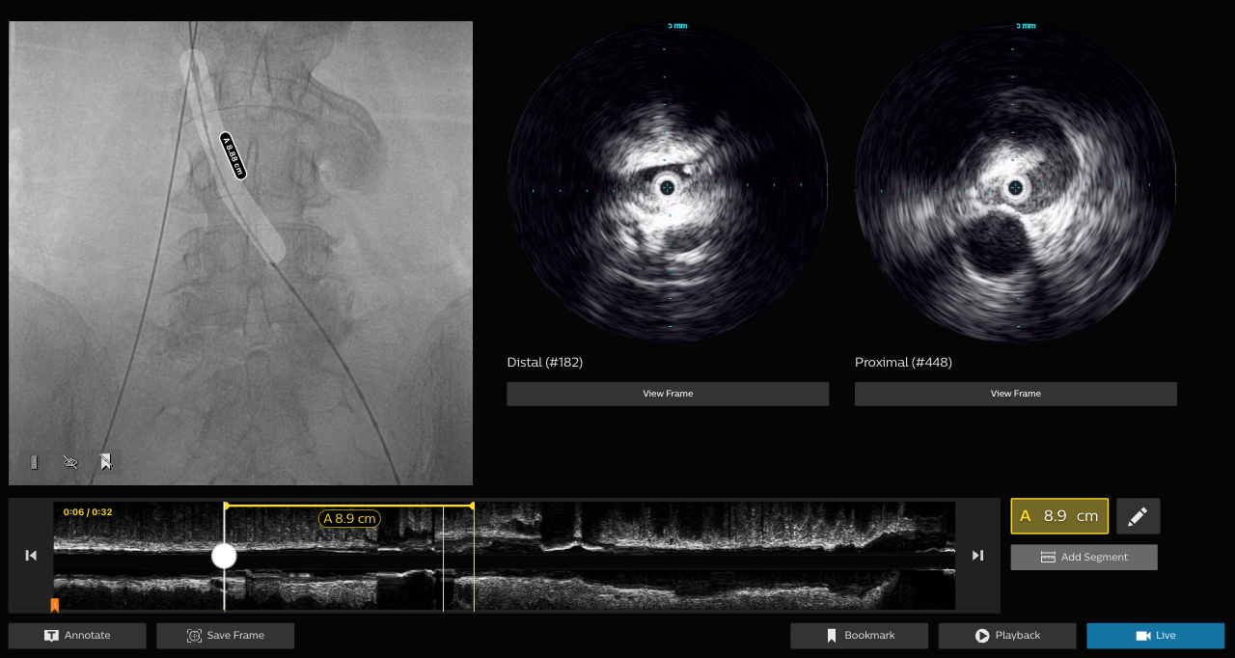
Near Future: Co-registered review and segment planning
04

Slide 5
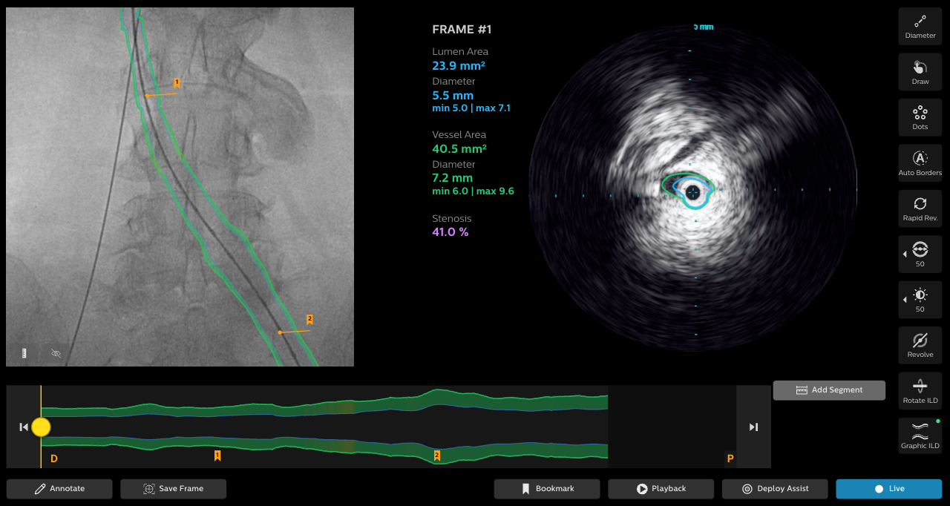
Distant Future: automated measurements
05

Slide 6
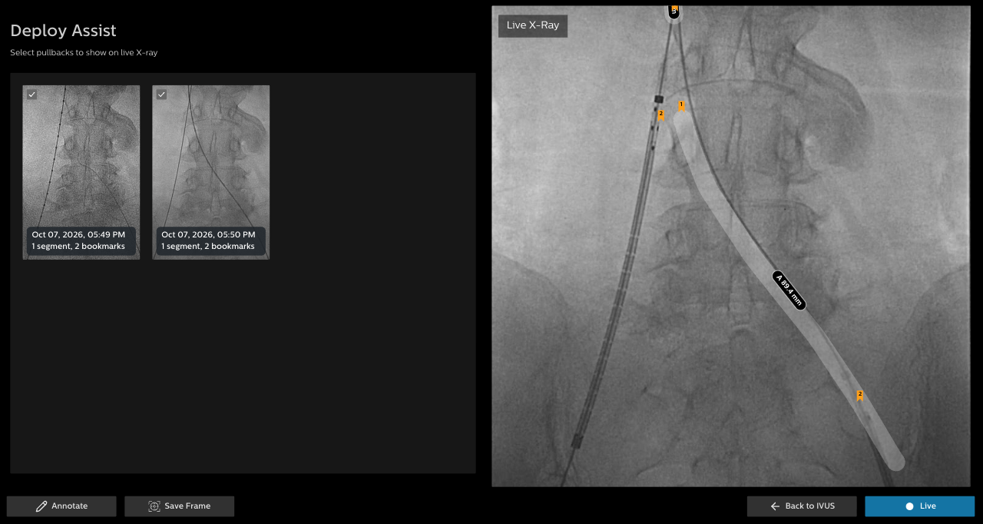
Deploy Assist: planning marks on live X-ray
06

Slide 7
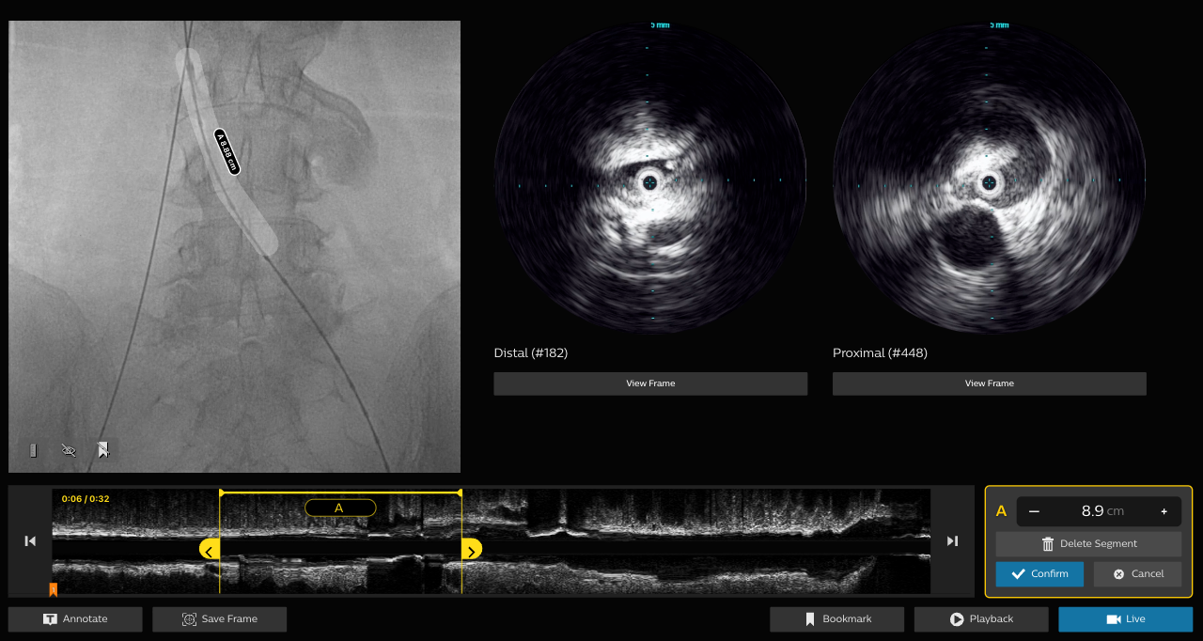
Quick marking and detailed planning serve different needs
Different starting points
Some assess live. Others see value in recorded segment review.
Design implication
Keep quick bookmarks alongside optional detailed planning.
07

Slide 8
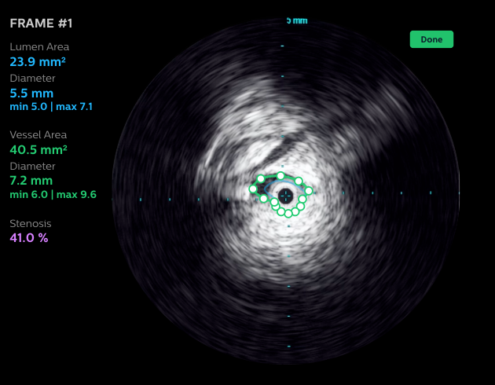
A measurement number needs visible evidence
What users need to verify
Which geometry produced this value?
Design implication
Show the measurement diameter lines and provide usable contour correction.
08

Slide 9
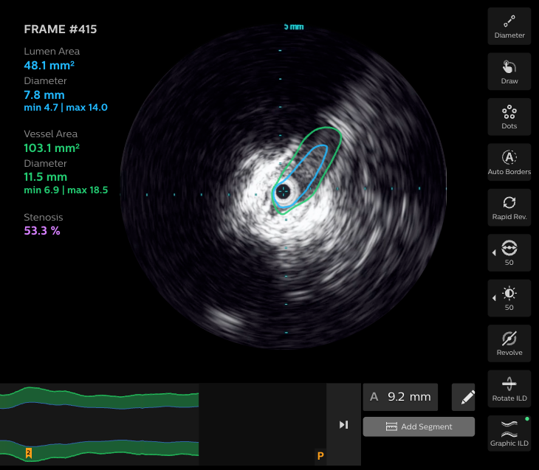
The selected slice and color meanings need to be clear
Observed misunderstanding
A slice-level measure was initially read as a segment-level result.
Design implication
Label metric scope and keep visual meanings consistent.
09

Slide 10
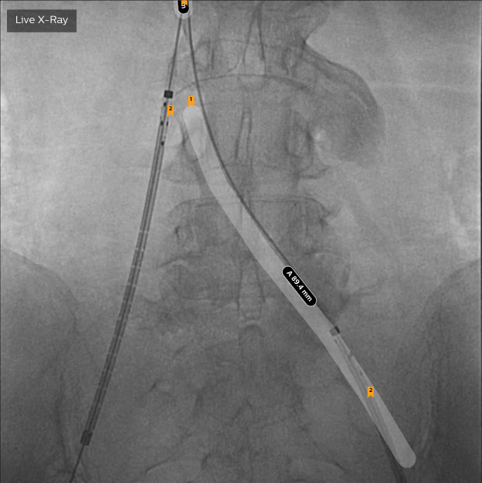
Deploy value centers on landing-zone positioning
Core need
Carry planned locations into positioning with fewer steps.
Open question
Does a separate mode help, or could live bookmarks provide enough value?
10

Slide 11
Overlay may need change during deployment
During positioning
After initial opening
Users need confidence that marks still align after breathing or movement.
One account describes removing marks once the stent starts to flare.
11

Slide 12

Control access shapes
the workflow
The clinician may not own the controls.
Test with the person who creates,
checks and clears annotations.
Support can differ when the
representative is absent.

Slide 13
Review ranks high; Deploy Assist varies
Feature | X | Y | Z
F1 IVUS + X-ray review | 2 | 1 | 2
F2 Segment length | 4 | 4 | 4
F3 Bookmarks & Segments on X-ray | 1 | 3 | 3
F4 Deploy Assist | 5 | 3 | 1
F5 Auto measurements | 3 | 2 | 1
Three unlinked submissions
Review: rank 1 or 2
Segment length: rank 4
Deploy Assist: rank 1 to 5
1 = most valuable. Ties retained.
No combined ranking with transcripts.
13

Slide 14
Recommended scope for the next design iteration
Refine the existing experience
Quick bookmarks, explicit metric scope and visible measurement geometry.
Prototype the unresolved behavior
Alignment re-checks after movement and information changes during deployment.
Keep exploratory ideas separate
Device-tip tracking and advisory sizing need their own evidence and testing.
14

Slide 15
The next test should expose the remaining unknowns
Verification
Movement
Can users identify and correct a deliberately wrong contour?
What do users do when the image and planned marks no longer align?
Ownership
Feature value
Who creates, checks and hides annotations during the handoff?
Can users rank capabilities separately and explain the dependencies?
15

Slide 16
Evidence and interpretation boundaries
What this readout supports
Concept direction, workflow needs and specific comprehension issues.
What it does not establish
Clinical accuracy, measured time savings, independent task success or adoption.
Traceability
All sessions are recorded and transcribed
16

